Slide 1
INTRODUCTION
Since 1996, Santé Center for Healing has been recognized for its comprehensive, award-winning care. We specialize in treating substance use disorders, co-occurring mental health conditions (dual diagnosis), complex poly-addiction, trauma, compulsive sexual behavior disorder, disordered eating, other compulsive behaviors, and the unique needs of impaired licensed professionals.

Slide 2
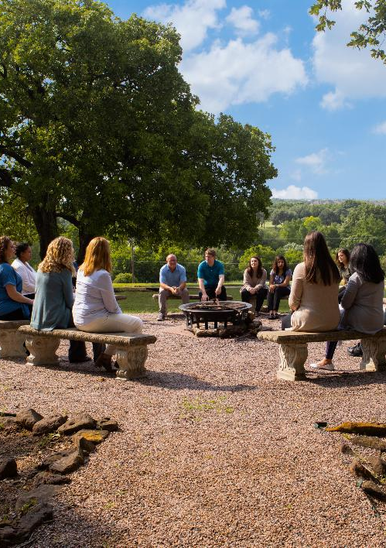

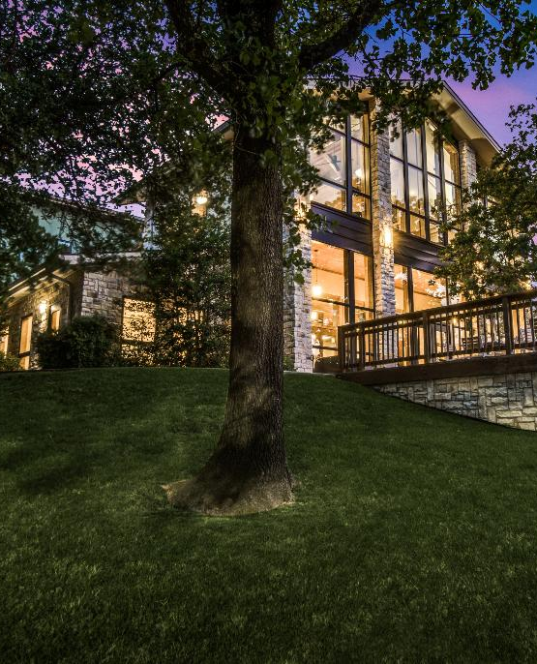
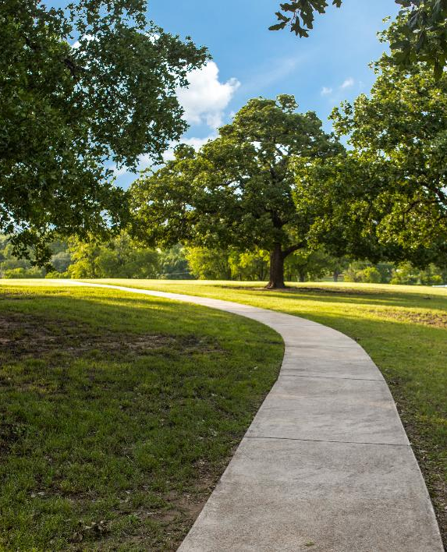
We don’t treat
a diagnosis; we help hurting individuals and families in crisis
who seek sustainable recovery from addictive substances, compulsive behaviors and associated conditions, including trauma.
On a transformative hill in Argyle, Texas, Santé has been fearlessly offering a pathway towards health, healing and recovery from substance use and other co-occurring disorders… all for long-term recovery… since 1996.
A clinical recovery continuum of care connecting medical detox, residential, day and evening intensive outpatient programming, transitional living, family support services, and life-long alumni support for best chance at long-term recovery.
Privately Owned
Family Owned
Clinician Owned
Locally Owned

Slide 3
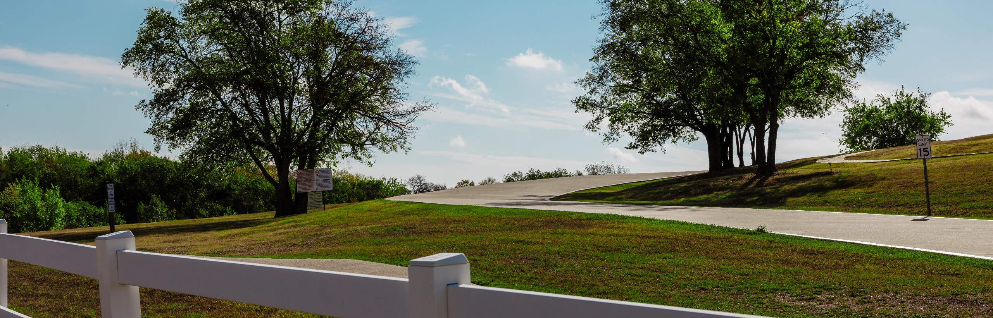
GET IT IN TOUCH
Miracles Happen on the Hill
Address
Santé Center for Healing
914 Country Club Rd
Argyle, TX 76226
Company
Main Line: 940.464.7222
Fax: 940.464.3023
santecenter.com
Josh Pitre,
MSW, LCSW, CSAT
Director of Clinical Services
Direct Line: 214.444.7346
JoshP@santecenter.com
Susan Sample,
LCSW
Regional Marketing Coordinator
Cell: 555.555.5555
SusanS@santecenter.com

